Slide 1
Programming II
Relationship between objects

Slide 2
Relationship
The relationship between objects defines how these objects will interact or collaborate to perform an operation in an application.

Slide 3
Relationship between objects
Composition and Aggregation
Message Passing/ Association
Inheritance

Slide 4
Composition
Composition is a way of aggregating objects together by making some objects attributes of other objects.
Relationship between two classes using the phrase has-a relationship
Person has a date of birth

Slide 5
Composition Vs Aggregation
According to some formal definitions the term composition implies that the two objects are quite strongly linked – one object can be thought of as belonging exclusively to the other object. If the owner object ceases to exist, the owned object will probably cease to exist as well.
If the link between two objects is weaker, and neither object has exclusive ownership of the other, it can also be called aggregation.

Slide 6
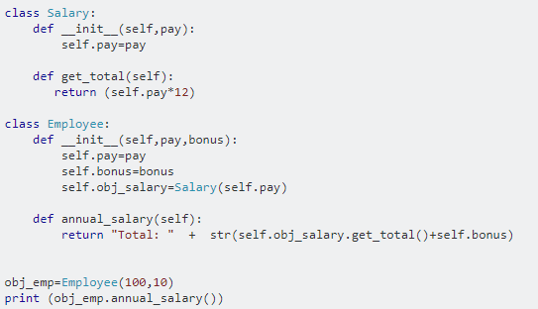
Composition
In composition one of the classes is composed of one or more instance of other classes. In other words one class is container and other class is content and if you delete the container object then all of its contents objects are also deleted.
Class Employee is container and class Salary is content.

Slide 7
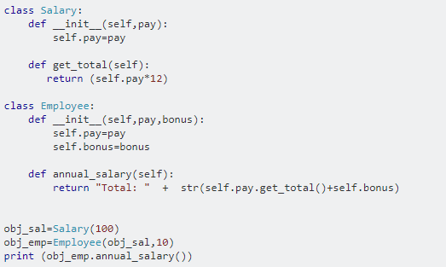
Aggregation
Aggregation is a week form of composition. If you delete the container object contents objects can live without container object.

